Slide 1
Investment and imports in russia
Which kind of relation?
JULIEN VERCUEIL, INALCO
Russian-French Seminar, Moscow, 12-14 February 2018

Slide 2
Russia’s investment record during the last two decades: an international comparison
Investment and Imports. J. Vercueil / Russian French Seminar, Moscow, 12-14 February 2018
2008-2016
1999-2007
Source : Author’s elaboration, world Bank data

Slide 3
Recent investment activity in Russia (2010-2017)
Investment and Imports. J. Vercueil / Russian French Seminar, Moscow, 12-14 February 2018
Source : Author’s elaboration, Rosstat data

Slide 4
Imports intensity of Capital Investment
Investment and Imports. J. Vercueil / Russian French Seminar, Moscow, 12-14 February 2018
(Roughly) estimated elasticity
of Machinery imports to Fixed capital investment :
+0,9 (OLS, R²=0,33)
Source : Author’s elaboration, Central Bank of Russia and Rosstat data

Slide 5
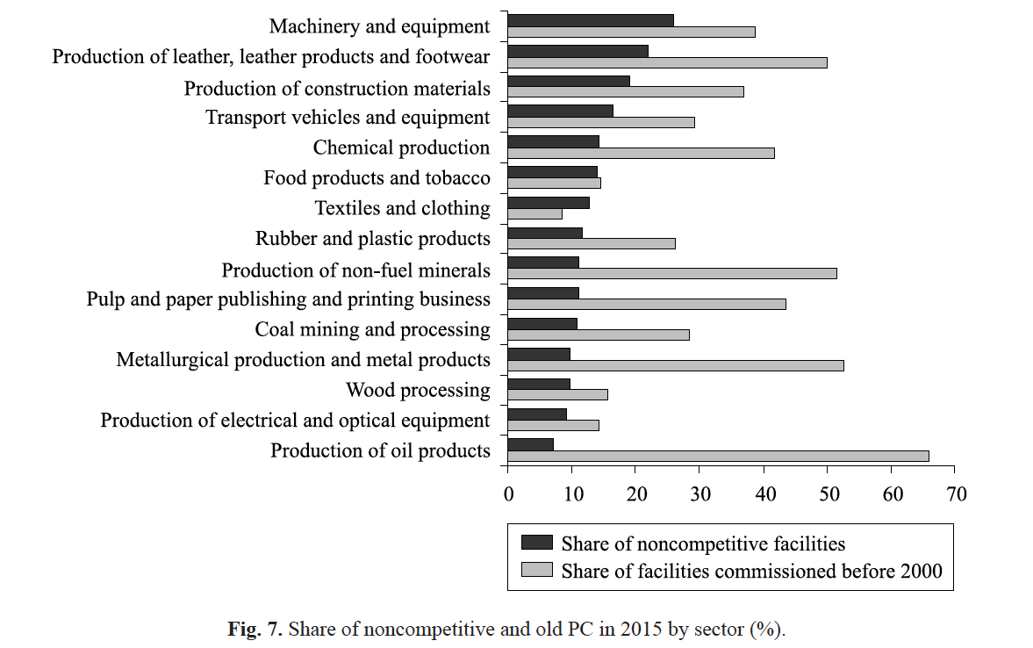
A theoretical framework to analyse the investment-import link
Investment and Imports. J. Vercueil / Russian French Seminar, Moscow, 12-14 February 2018
Weak domestic production of capital goods
Exports and currency earnings,
Profits of main investing Russian firms,
Fiscal revenues of public administration
Raw material
prices
Public and
private investment
Import of capital goods
Source : Sel’nikov et alii, 2017
Source : Author’s elaboration, Central Bank of Russia and Rosstat data

Slide 6
An empirical illustration: regional data
Investment and Imports. J. Vercueil / Russian French Seminar, Moscow, 12-14 February 2018
Source : Author’s elaboration, Rosstat data

Slide 7
Conclusion: facing the import-investment link
Investment and Imports. J. Vercueil / Russian French Seminar, Moscow, 12-14 February 2018
Investment is partly driven by oil prices => another example of the consequences of the structural growth model of Russia
FDI could be part of the solution – but they can also foster imports (even imports of machinery and equipments) – at least temporarily
A lot will depend on the capacity of the industrial sector to attract and leverage technology transfers – especially machinery and equipment industries (see F. List, T. Veblen, H.-Joon Chang)
In any case, capital outflows and investment climate are key (not merely to foreign investors)

Slide 8
Cпасибо за внимание !
Investment and Imports. J. Vercueil / Russian French Seminar, Moscow, 12-14 February 2018
Sources :
Central Bank of Russia (2017) : Monetary Policy Reports
Идрисов Г.И., Каукин А.С., Павлов П.Н. (2017) : Импортозамещение товаров инвестиционного назначения в России, Report for Федеральное государственное бюджетное образовательное учреждение высшего профессионального образования
Кувалин Д.Б., Моисеев А.К., Лавриненко П.А. (2018) : Российские предприятия в конце 2017г.: отсутствие значимых общеэкономических изменений и прогресс в машиностроении (Обзор результатов опроса, проведенного в ноябре-декабре 2017г.; бумажная версия статьи будет опубликована в 3-м номере журнала «Проблемы прогнозирования за 2018г.)
Rosstat (2017, 2018) Database
Salnikov V., Galimov D., Mikheeva O., Gnidchenko A., Rybalka A. (2017) : « Russian manufacturing production capacity: primary trends and structural characteristics », Russian Journal of Economics, 3 (2017), p. 240-262.
World Bank (2017) Russian economic Reports

