Slide 1
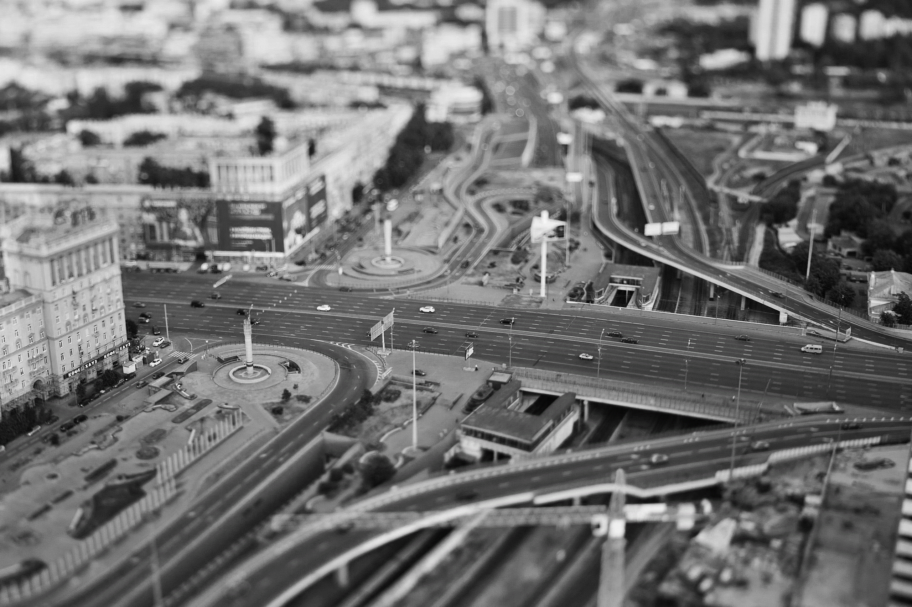
The ways of interaction between the state and private partners influence economic development
LV Session of the Russian-French Seminar on Monetary and Financial Problems
By Leonov Ilia 09/2018

Slide 2
Actual ways of financing infrastructure projects
Concession agreements
Municipal bonds (Infrastructure mortgage)
Tax Increment Financing (TIF)
protection of interests of public partner
private partner

Slide 3
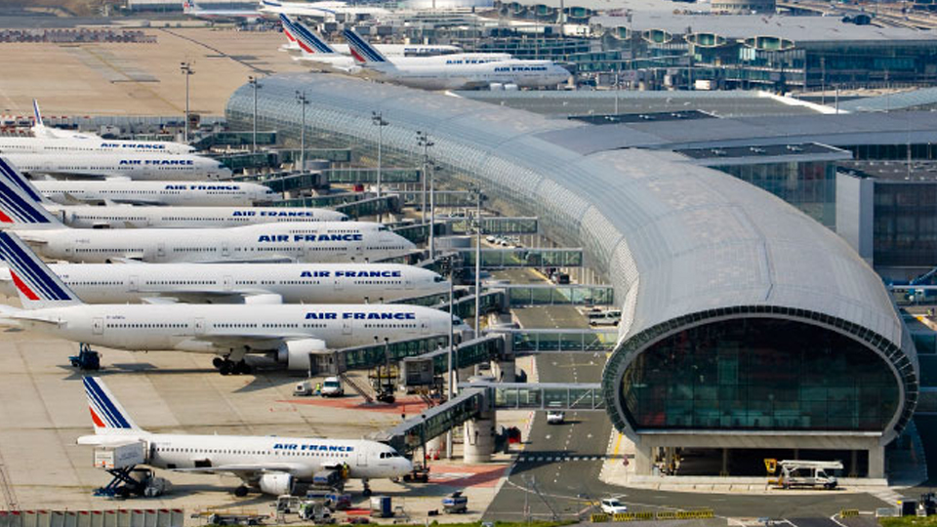
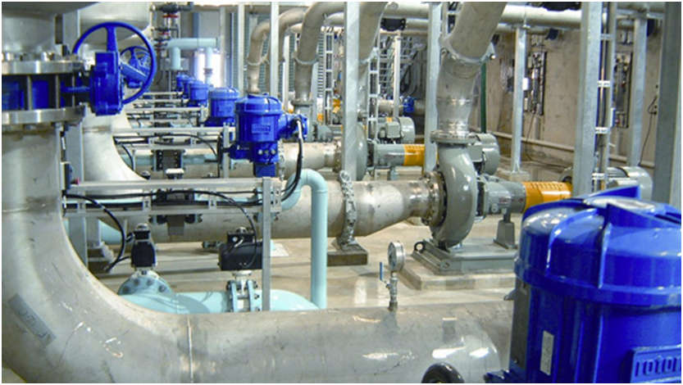
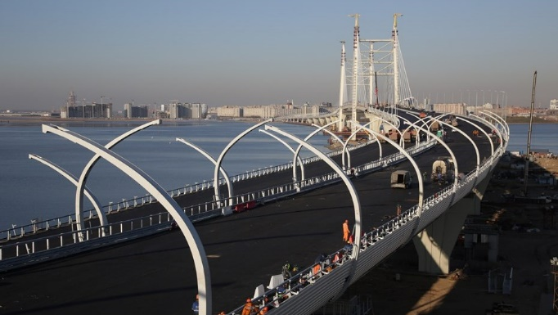
Concession agreements
Work well in industries with a high level of competition such as airports
Used frequently in industries associated with the possibility of fees for use. Power/Water supply, toll roads, etc.
Unequal relations. Highly protected interests of a state partner

Slide 4
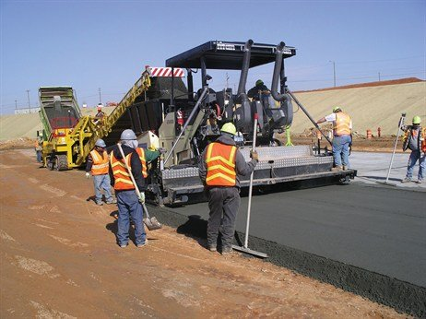
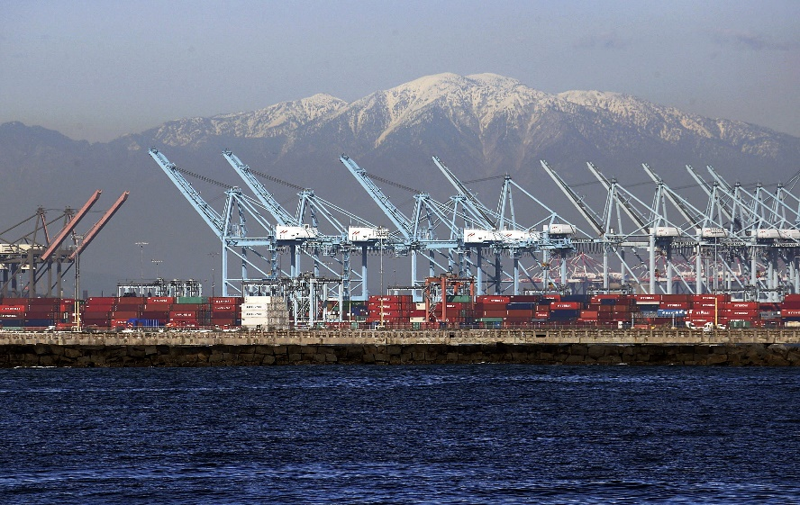
Infrastructure mortgage, municipal bonds (etc.)
Municipal bonds are obligations that entitle owners to interest plus repayment of the principal at a specified date.
States and localities issue bonds to large, expensive, and long-lived capital projects, like the construction and maintenance of bridges, hospitals, schools, seaports, and infrastructure-related repairs

Slide 5
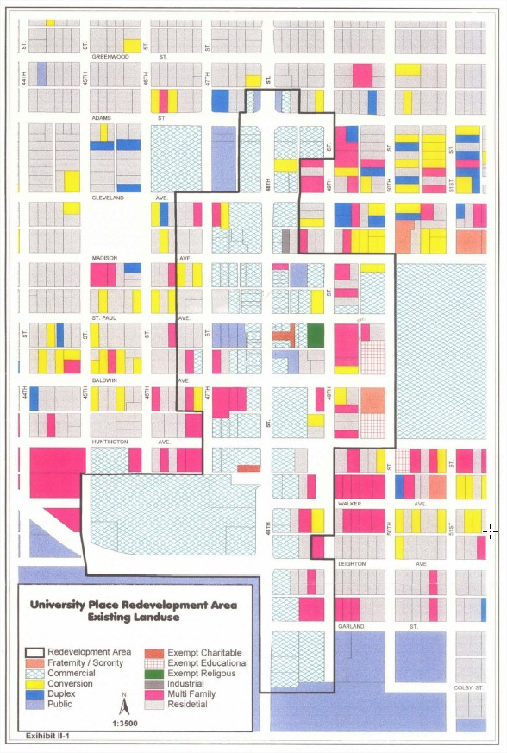
Tax Increment Financing
Private partners are motivated to maximize economic development
Highly protected interests of a private partners
TIF
end
date

Slide 6
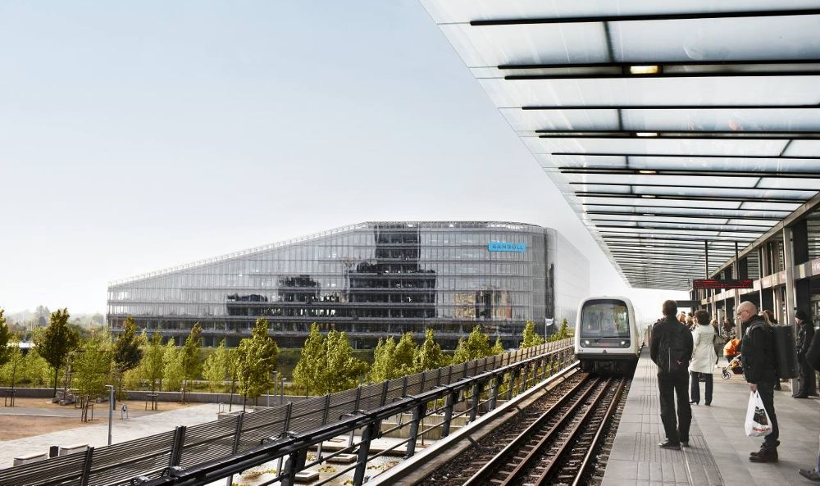
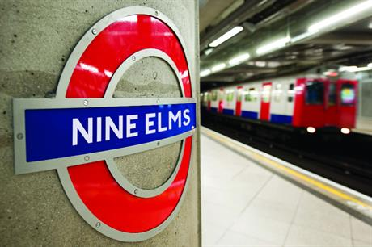
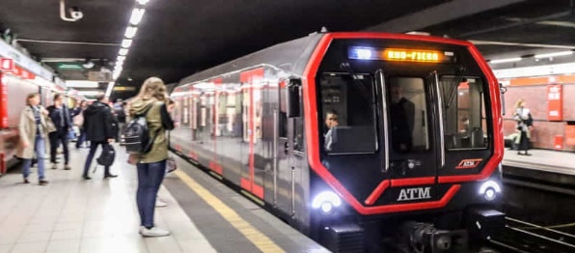
How the TIF affects development
World experience
PROJECT | DESCRIPTION
Helsinki Metro, Finland (1982) | The only metro operating in Finland has been in operation for 25 years. Property prices within walking distance of nearest metro station have risen by 7.5% over other locations. Impact was most significant at a distance of 500 - 750m, as opposed to adjacent locations, where value dropped
Copenhagen metro and Ørestad scheme, Denmark (2002-2007) | The Copenhagen metro and Ørestad scheme is a recent metro development which had a total cost of EUR 1.6 billion. Value was created from the design and construction of the new metro line. The increased accessibility to the adjacent land raised demand for it among developers and investors. 52% of the whole site was sold or under construction by the end of 2006, with overall sales totalling EUR 623 million. Furthermore, value was captured from direct payments (10%), real estate taxes (10%), and operating profits from metro (30%). Finally the captured value paid for the construction of the metro by repaying the EUR 2.3 billion debt incurred during construction process.
Jubilee line, London, UK (1992-2000) | London’s Jubilee Underground extension cost £3.5 billion, raising the nearby land’s rental value by £1.3 billion. Public collection of 25% of that increase would pay off the Jubilee line in 20 years.
Metro Toronto Subway, Canada (built during 1950s. and 1960s.) | Metro Toronto Subway was constructed during the 1950s and 60s. Analysis concluded that the tax assessment value near the city centre increased by 45% and by a massive 107% in the region of the suburban stations compared to a 25% increase in other areas. Along with these significant rises it was noted that rentable value of office space adjacent to the station were, on average, 30% higher than in the city as a whole. Another noteworthy indicator was that 90% of new office space and 40% of apartment buildings between 1959 and 1964 were constructed beside metro lines
Tyne&Wear Metro, Newcastle, UK (1980-2008) | Average increase of £360 (1.7%) in the value of properties near metro stations during the four-month period surrounding the date on which each section of line opened.
Milan Metro, Italy | The special levy, “specific improvement assessment”, was assessed on properties within 500m of station. This form of LID had raised 36 billion lire, but following its initial success the levy was replaced by a real estate transfer tax that feeds into the local general fund.

Slide 7
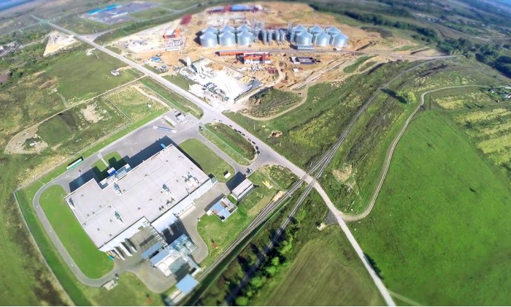
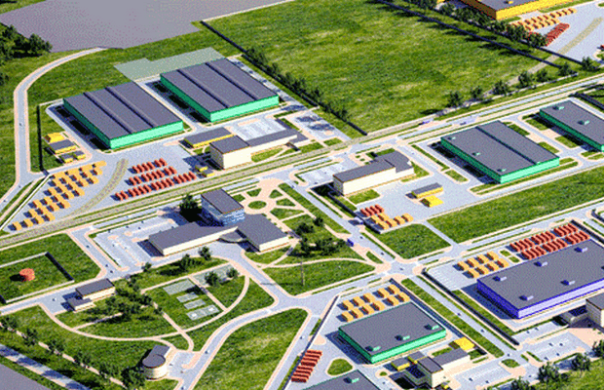
How the TIF affects development
Russia experience
Since 2007, the government has invested 14 bn. rubles in the infrastructure of these industrial parks. Of which 10 billion is a loan from VEB.
Total volume of investment made by residents of industrial parks is more than 233 bn. rubles, which gives us a 1:15 ratio public to private investments
For the same period of time, budgets of all levels have received about 76 bn. rubles from residents of industrial parks

Slide 8
Сomparison of some industrial regions of Russia
Nominal growth of 2006/2018
 | НАЛОГИ НА ПРИБЫЛЬ Income Tax | НАЛОГИ НА ИМУЩЕСТВО Property Tax
Калужская область (Kaluga region) | 442% | 447%
Челябинская область (Chelyabinsk region) | 221% | 291%
Свердловская область (Sverdlovsk region) | 219% | 370%
Архангельская область (Arhangelsk region) | 275% | 449%
Тульская область (Tula region) | 349% | 362%
Московская область (Moscow region) | 374% | 454%
Ленинградская область (Leningrad region) | 376% | 569%
Республика Татарстан (Republic of Tatarstan) | 337% | 380%
Самарская область (Samara Region) | 202% | 323%
Нижегородская область (Nizhny Novgorod Region) | 255% | 335%
Ростовская область (Rostov region) | 352% | 479%

